Slide 1
Press Enter Or Click To START

Slide 2
بـه نـام خـــدا
In the name of GOD

Slide 3
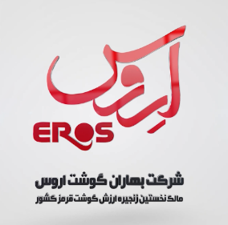
Baharan Goosht Eros
The first integrated value chain of red meat in Iran

Slide 4
Baharan gosht eros company established since 1987 and located in Golestan province in the North of Iran.
The field of our company is producing, processing, distributing different kind of protein products.

Slide 5
In order to increase the products quality and optimize its process, our company created a structure with connected parts like several rings of a chain that complete each other and make a cohesive complex.
L1
Livestoccks fodder produce
L2
Livestocks husbandry:
L3
L4
L5
L6
Industrial slaughter house:
Meat segmenting and packing complex
Factories of protein products
shopping centers

Slide 6
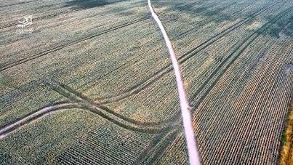
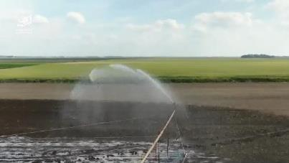
Livestock fodder such as corn, wheat, oat, straw and… produces in company's mechanized farms and with modern irrigation systems.

Slide 7
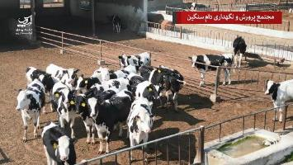
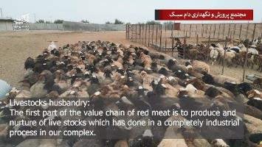
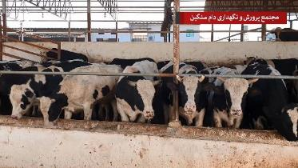
One of the most important parts of our company is the live stocks husbandry which has done with modern techniques and under the direct supervision of our specialists.
Actually right now our husbandry department in not able to respond to all our production capacity and this aim is one of our future outlook and goals.

Slide 8
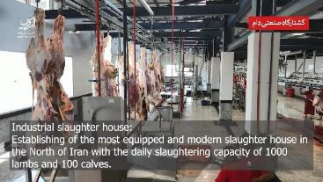
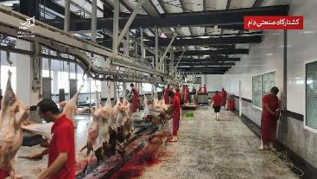
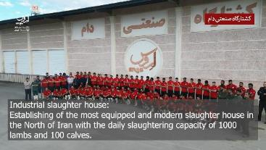
Industrial Slaughterhouse
One of the most equipped and modern slaughterhouse in Iran with the daily slaughtering capacity of 1000 lambs and 100 calves

Slide 9
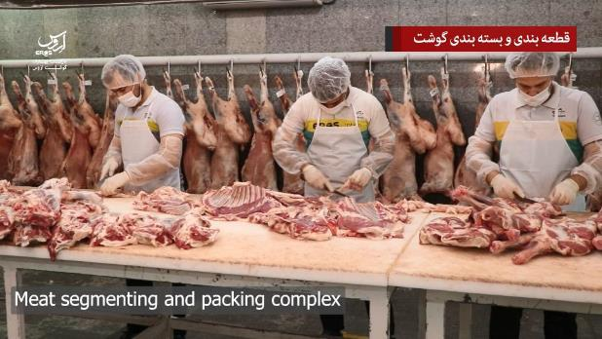
Meat segmenting and packing complex
Segmenting carcasses is done in a completely mechanized and hygienic place and packing process under the global standards.
The daily produce capacity is about 10 tons and distributed in fresh and frozen packs.

Slide 10
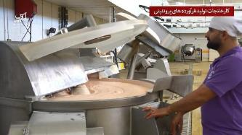
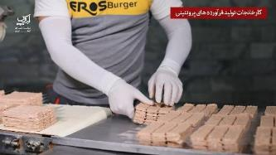
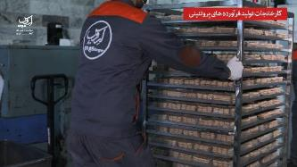
Factories of protein products:
Eros protein products such as burgers and sausages with eros and rohita brands.

Slide 11
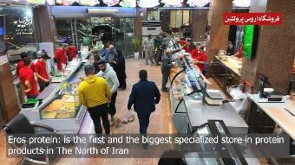
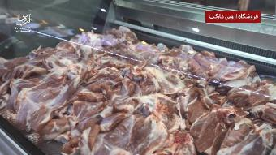
Products Distribution
Our products is distributed in two ways:
wholesaling into Government organizations, private companies and chain stores.
retailing in our own shopping centers and hyper markets.

Slide 12
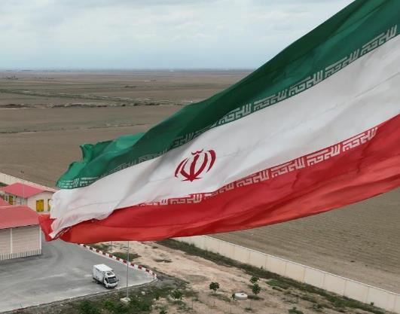
Baharan Goosht Eros as the greatest complex of producing and distributing of protein products in the north of Iran, has acted to develop the industrial of producing and meat manufacturing, and also presenting services and divers products with high quality.
We are trying to keep this goal for our further actions and reach to the higher levels.

Slide 13
www.EROSCO.ir
for more information and pictures

Slide 14
پایان
The END

